Slide 1
Building Custom Tools
to Boost Marketers' Productivity in SFMC
Notes:
Welcome everyone! I’m thrilled to kick off this session on extending the capabilities of Marketing Cloud Engagement. Whether you're here from the business side looking to solve complex marketing challenges, or you're a developer eager to build smarter, more efficient tools—this session is for you. We'll explore how custom development can unlock new possibilities, streamline operations, and empower teams to do more with Marketing Cloud.

Slide 2
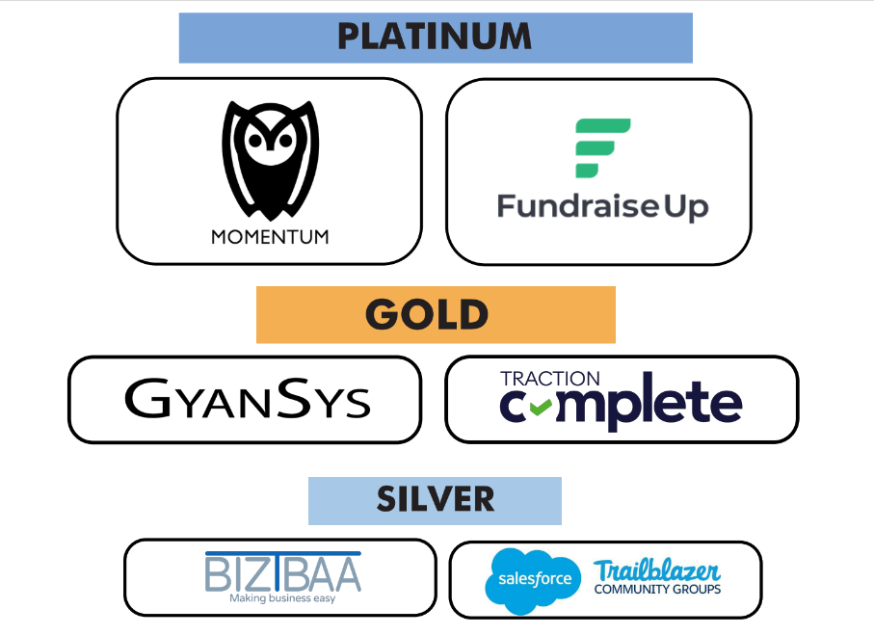
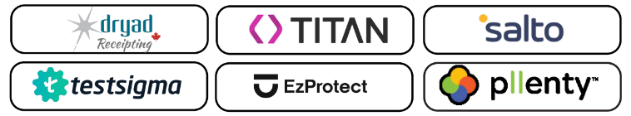
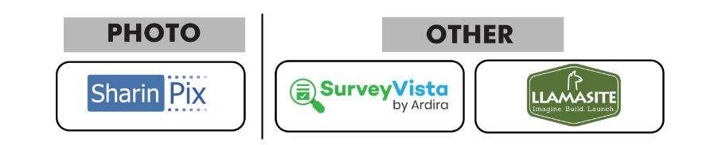
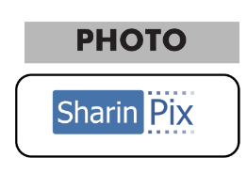

TND 2025 Sponsors
Notes:
Before we start, a quick note of thanks to all our sponsors, for making this wonderful event a success.

Slide 3

Introduction
About Me
Solutions Architect at CloudKettle, a Bell Canada Company
CloudKettle is a Salesforce Summit Partner based in Halifax, Nova Scotia
E: mathes.kanagarajan@cloudkettle.com
L: https://www.linkedin.com/in/mathesk
W: www.cloudkettle.com
Mathes K
Notes:
About me - My name is Mathes K, I’m an accidental marketer, and about 8 years back, the MC email world chose me and the community taught me all I know about SFMC and Salesforce.
I work as a Solution Architect at CloudKettle, and CloudKettle is a Salesforce Summit Partner based in Halifax, Nova Scotia.

Slide 4

Building Custom Applications in MCE
Marketing Cloud is powerful out-of-the-box — but true innovation happens when we extend it.
Notes:
MCE is a complete package and powerful tool for omni channel marketing which supports all range of businesses - from small to large scale enterprises. But to enhance and address all your complex business requirements and integration patterns, be it realtime integration with slack to notify about a customers event, or send logs to snowflake or one of your internal application, or build a well templated email, we may have to extend its capabilities with available SDKs.
One of the key difference between Marketing cloud Engagement and other marketing platforms is it’s availability of SDKs and APIs - almost every aspect and functionality of MCE can be accessed with APIs.
(funny) Well - if anybody fancies, you can build your own custom marketing application and use MCE as a headless platform, though I wouldn’t recommend, it’s quite possible, for a brave soul!

Slide 5
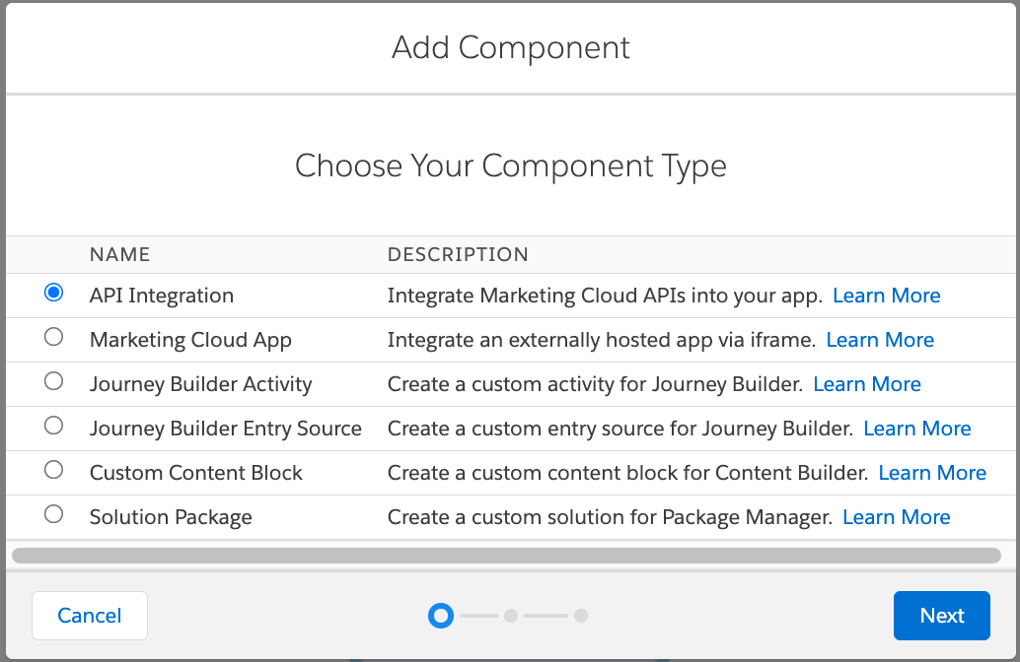
Types of MCE Apps
Custom Content Blocks
Custom Journey Builder Activity
Custom Apps
Chrome Extension
Notes:
In the next 45 minutes, I’m going to share my app building experience in marketing cloud engagement, the what’s, the why’s and the how’s of it.
The what’s - is where we’ll discuss about what’s available - the types of apps we can build.
The why - helps us decide if the specific use case or problem statement requires a custom app or can they be solved with existing available methodologies or tools
The how - is where we’ll explore about different sdks, frameworks, apis and other available avenues for building a tool.
Circling back on the ‘what’s available’ in marketing cloud,
(click) we can build custom content blocks that would help build an email… and journey builder activity to enhance your customer orchestration flow, and a marketing cloud app - for things like a dashboard.. All these three are iframed applications and have cross-origin communication libraries as part of their respective SDKs.
If you note this, we don’t have ‘automation studio’ and if you ask me, the ‘script’ activity in automation studio acts as a custom app - where you can have your own set of logic and solve problems.

Slide 6
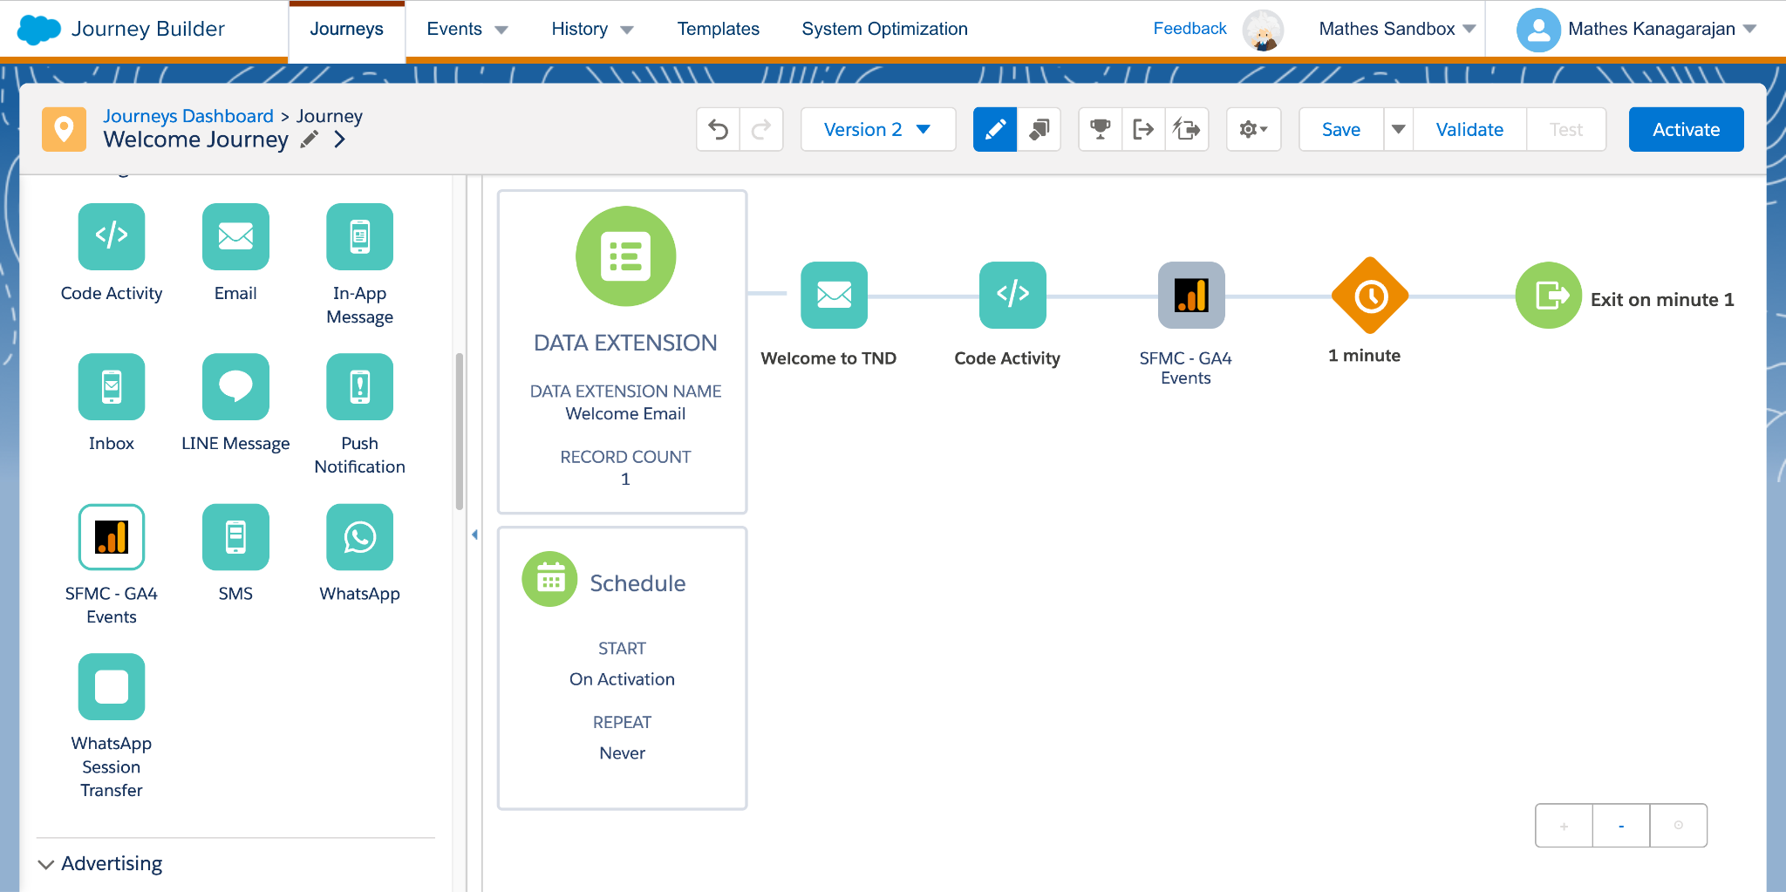
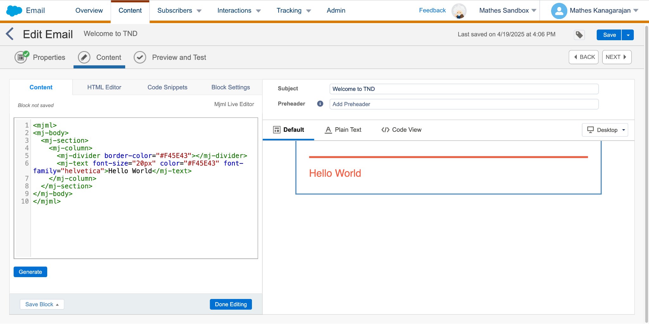
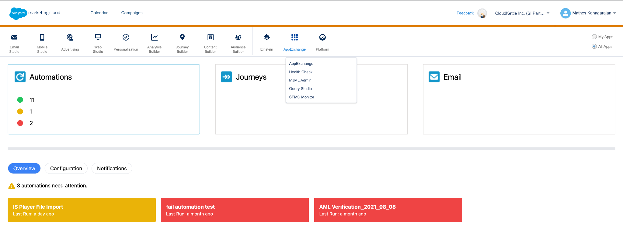
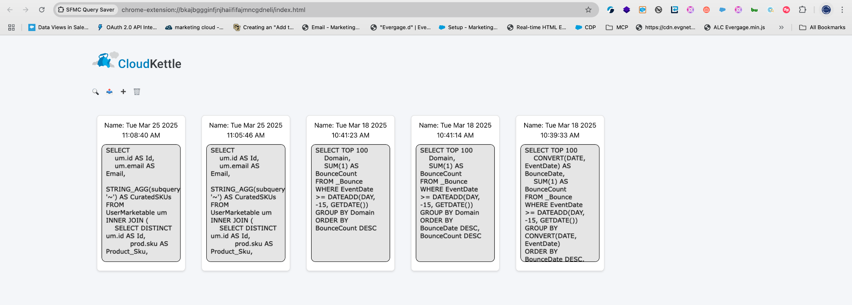
Introduction
Types of Apps
Custom Content Block
SDK Docs
Journey Builder
Entry Source
Activity
Docs
Marketing Cloud App
Docs
Fuel SDK
Chrome Extensions
Notes:
In the next 45 minutes, I’m going to share my app building experience in marketing cloud engagement and the available sdks -
First,
Email studio - where we build emails and reusable content blocks. While we have quite a few useful blocks - like rich text editor, image block, dynamic block, there might be a scenario where you might want a custom block that solve ‘your’ problem statement.A simple example is to have a text over an image - the most common one, and unfortunately, there’s no content block for that. OR for a bit of complex use case, use mjml for building emails - and you can build a mjml editor like we’ve done at CloudKettle.
Journey Builder - where we orchestrate a customer’s journey and like email studio, it has quite a lot of useful ootb activities like Email, SMS activities, data-based decision splits, activities to update salesforce objects - thats nice. But what if you’d like to update your internal system in realtime or send out sms from amazon service or even better, use data from data cloud - data graphs - in your decision split ? that’s where we can build a custom journey builder activity that can invoke an external system when a customer passes through the activity and the now, there’s an endless opportunity to integrate different disparate systems with marketing cloud journeys
Marketing Cloud App - the most common app a MCE developer sees day-to-day is ‘Query Studio’ - which is an app developed by Salesforce Labs and hosted in Heroku. Similarly, you can develop a custom app, for example, a custom marketing cloud monitor, deploy into a server of your choice and have it available for your users to monitor
And last but not least, chrome extensions. These are browser extensions that extends from your chrome browser - much like the famous ‘Salesforce Inspector’ that sticks to the right side like a clippy and when needed, brings you a swiss army knife of tools to run SOQL, to get details about object and much more.. You can build something similar in marketing cloud as well - and believe me or not, there are quite a few extensions that are available - Notably, SFMC companion by Cameron Robert - is a swiss army knife for a marketing cloud developer. On a related use case, at CloudKettle, we’ve built SFMC Query saver - that saves all the queries that you execute in query studio and generally is liked by the folks in sfmc community ;)
Alright now, let’s get into the meat of this - the architecture, design and if possible, some demo of these apps.

Slide 7
Custom Content Block

Slide 8
Custom Content Block
When to build one? Use cases
Custom WYSIWYG editor for your brand
Templated Emails that can be generated by filling form
Fetch contents from your own CMS (like Strapi)
Complex personalization or integration
Personalized Calendars, Maps, Graphs or Charts
Dynamic image generation with personalized text
Notes:
First, let’s start with Custom Content Block and when you want to build one…
Here are some of the use cases that I’ve come across -
A custom WYSIWYG editor that’s on brand - that follows the colors and styles of your brand
Next is something we’ve implemented for some of our customers at CloudKettle - where there were a set of repeated email templates that gets sent often by business users who weren’t comfortable editing HTML codes - so, we ended up building a ‘form-like’ content block that a business user can fill in and generate a outlook compatible email that passes litmus testing with summa cum laude - with flying colors
A mjml editor - for fellow MCE developers
A custom integration with CMS to bring in and re-use the available assets in CMS — and the list goes on and on..

Slide 9
Custom Content Block - SDK
Building a custom content block is a 3 steps process
Creating app with Block SDK
Deploying the app in a publicly accessible Server (like Heroku)
Adding app in Installed Package
Block SDK - https://github.com/salesforce-marketingcloud/blocksdk/blob/master/blocksdk.js
Notes:
What are the components of building a content block - the bare minimum - an index file, sdk file and icon file..
Index.html is the file that’s loaded by default - and of course, we can overwrite it. And, an icon and drag icon and the sdkh.
But Hold on - what’s the script? It’s called ‘block sdk’ that’s available in Salesforce’s github
https://github.com/salesforce-marketingcloud/blocksdk

Slide 10
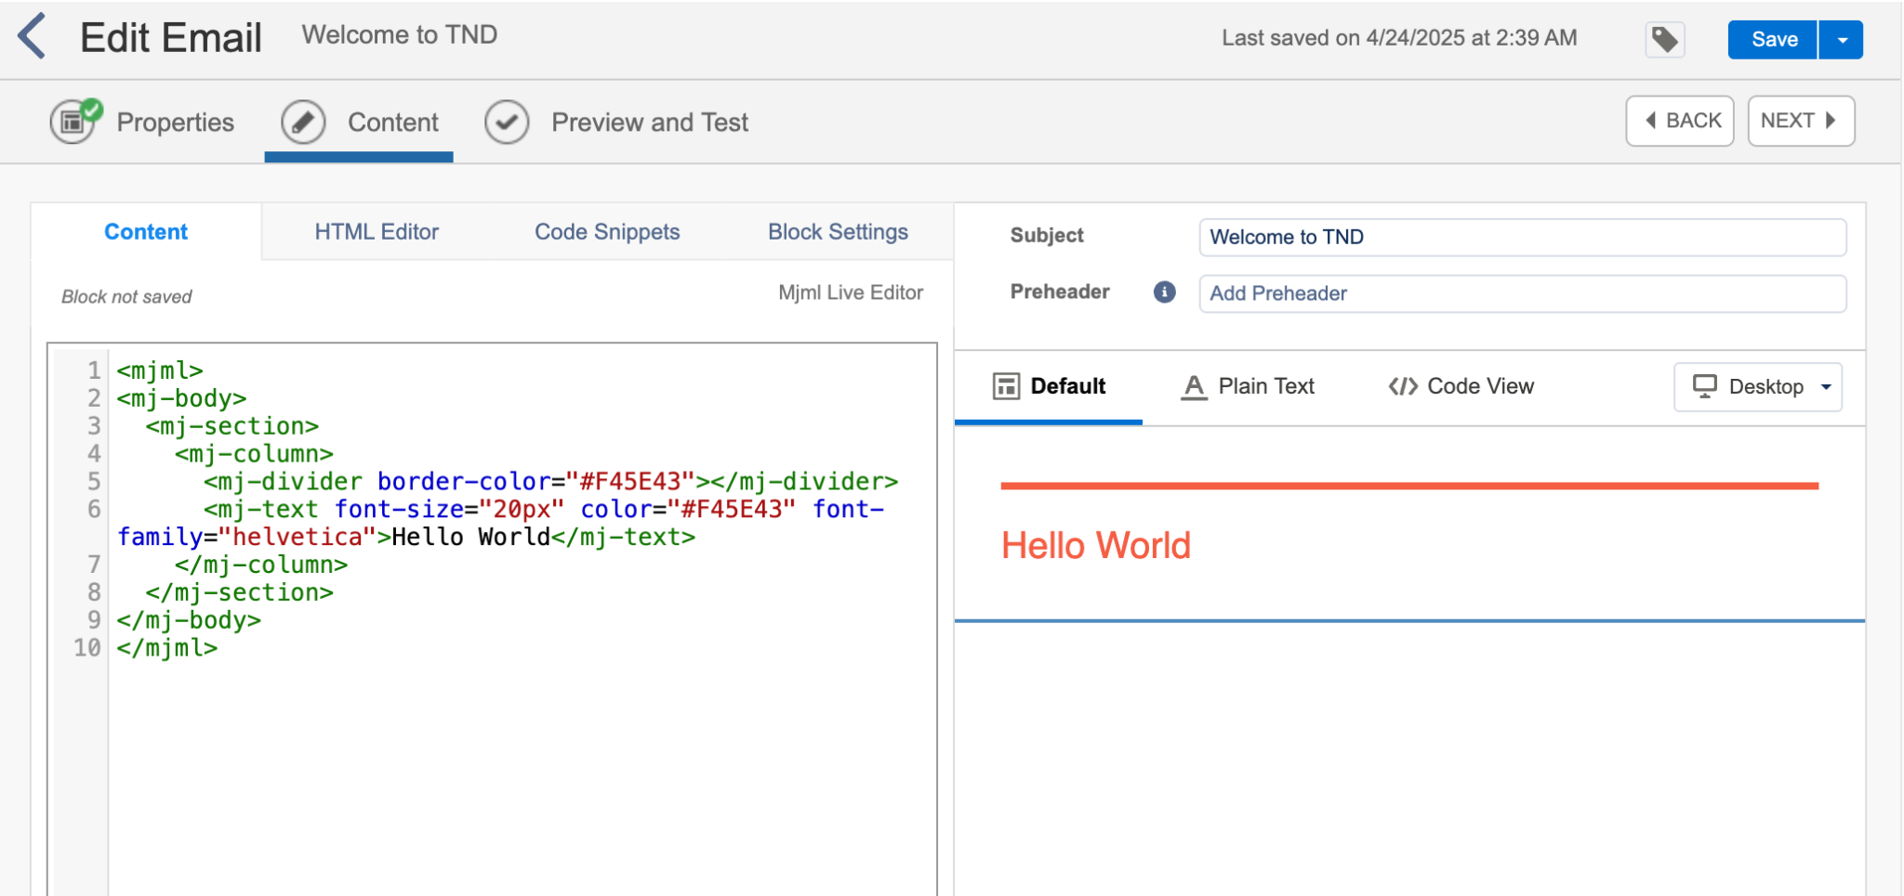
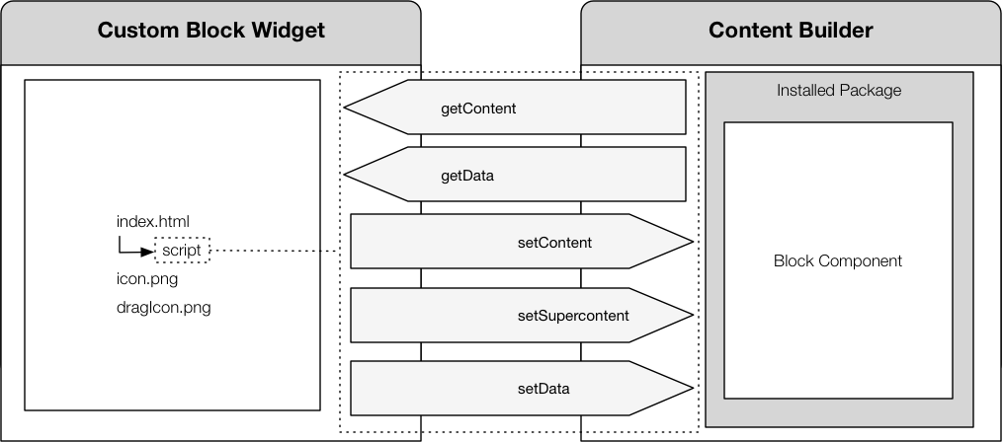
Custom Content Block
Architecture
Custom Block Widget
Content Builder
getContent
getData
setContent
setData
setSuperContent
triggerAuth2
Notes:
Let’s look at the architecture -
This is how a block in email studio looks like… (click) to the left, you’ve custom block widget panel and (click) to the right, we’ve the content builder.. (click) Custom block widget has index, icon and sdk files and is iframed.
Since the app is iframed, it needs a way to communicate with parent frame - and that’s where we use the block sdk. (click) Block SDK comes with few functions that helps communicate few information to the content builder.. Information like, what to show, what does it already have on load etc.,.
Before we dive deep, the app needs to be hosted on a publicly available web platform. An installed package can then be added to a Marketing Cloud account, which defines the app URL.
Note that - Content created by a custom block is interpreted by the same Outbound Mail Management (OMM) process, which means that the content created by the custom block widget needs to be valid HTML for MCE and can include ampscript, ssjs and GTL tags - see that’s a very important point.. Your custom content block can still use the capabilities of SFMC - ampscript and ssjs..
// var authUrl = "https://mcg8dmxkdj0y6f-5cbw5zrwy-54y.auth.marketingcloudapis.com/";
// var redirectUrl = "https://ef7c-2604-3d08-567e-870-f45e-a653-d16a-e3b5.ngrok-free.app";
// var clientId = "npa9gllnwqmaebvcby836jeq";
// var authInfo = {
// authURL: authUrl,
// clientId: clientId,
// redirectURL: redirectUrl
// }
// sdk.triggerAuth2(authInfo);

Slide 11
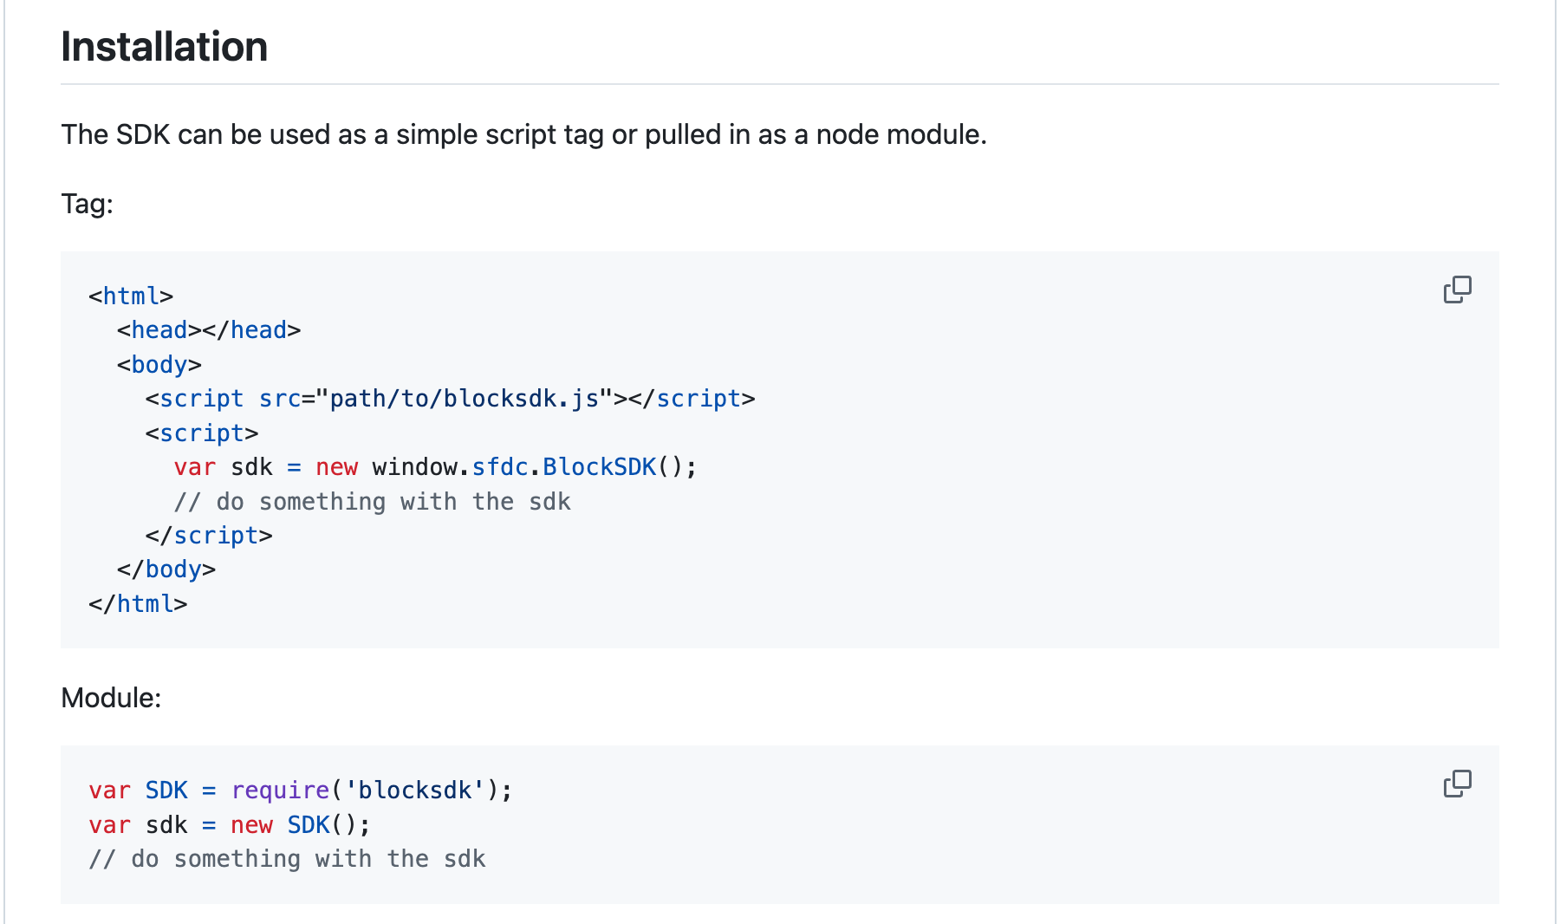
Custom Content Block
setContent: saves content that has been created or edited within the custom block widget
setData: sets data values that have been defined within the custom block widget
getContent: retrieves custom content from Content Builder; for example, content that has previously been saved
getData: retrieves data values that have been defined for the custom block; for example, form field values
setSupercontent: sets default content to display in Content Builder.
SDK Methods
https://github.com/salesforce-marketingcloud/blocksdk
Notes:
Now, how do I use the sdk.. First you reference it like this (click) and then declare it either as a variable or as a module (click)..
The SDK provides five JavaScript methods for enabling bi-directional communication of content and data between the custom block widget and Content Builder: Now, what’s the difference between content and data; content is what the user sees on the right side panel in content builder and data is any data or metadata that’s associated
Super Content refers to default content that is used for display purposes. Super Content is only used to display placeholder content where the actual content will appear — it’s not sent to OMM.
There are other important functions as well
new BlockSDK - Defines the block and here you can set required Tabs - eg., HTML, styling tab, custom tab etc.,
TriggerAuth or Auth2 - to get access token and further access assets within the instance - eg., images / data extension etc.,

Slide 12
Custom Content Block
Demo time!! *
*At the Mercy of Demo Gods!
Notes:
Ok - let’s look at some demo.. And fingerscrossed!!
All the code is available in - https://github.com/matheswarwan/TND25
Load Demo from Desktop/TND/ContentBlock/alc-custom-content-block-main and run ‘npm run dev’ and then start ‘ngrok http 5173’

Slide 13
Custom Journey Builder Activity

Slide 14
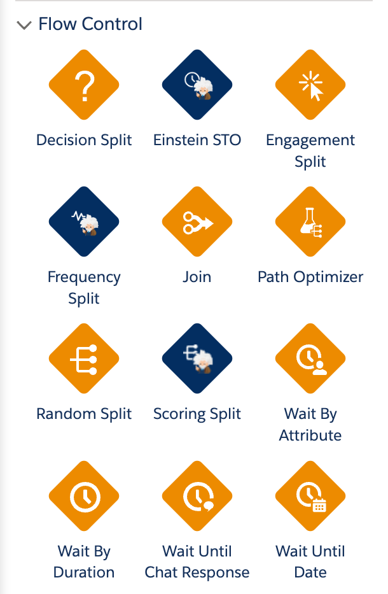
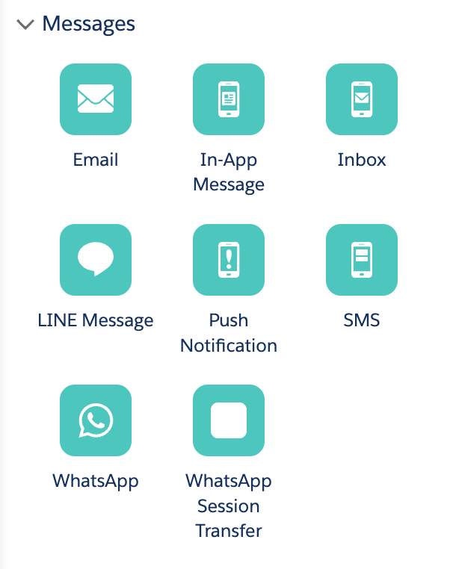
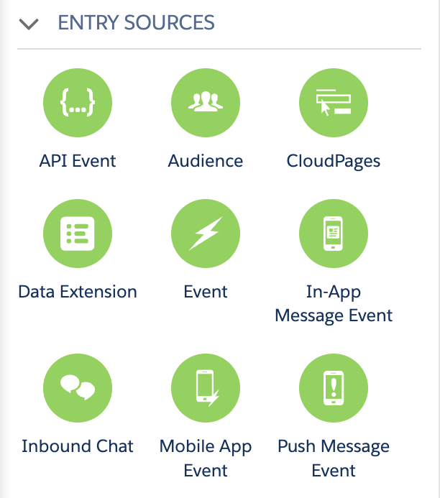
Custom Journey Builder Activity
Activity Types
Entry Source
Flow Control - eg., decision split
Messages - eg., Send SMS
Customer Update - eg., update profile attribute
Custom - eg., others
Notes:
Journey builder canvas has, by default, a lot of activity types..

Slide 15
Custom Journey Builder Activity
Use Cases
External integration like - connecting with Slack / Sending data to your DW/ BI systems when a customer crosses a stage
Integrating 3rd party SMS systems
Realtime data lookup from systems like Data Cloud, Snowflake or others
Custom Decision Split with Multi Armed Bandit
Notes:
Here are some use cases that we could solve..

Slide 16
Custom Activity Trail Map
Code
Deploy
Add to MCE
Use in Journey
Code your custom journey builder activity & test it.
Deploy in a hosting service (like Heroku)
Create Installed package and add your app
Configure the activity & execute the journey

Slide 17
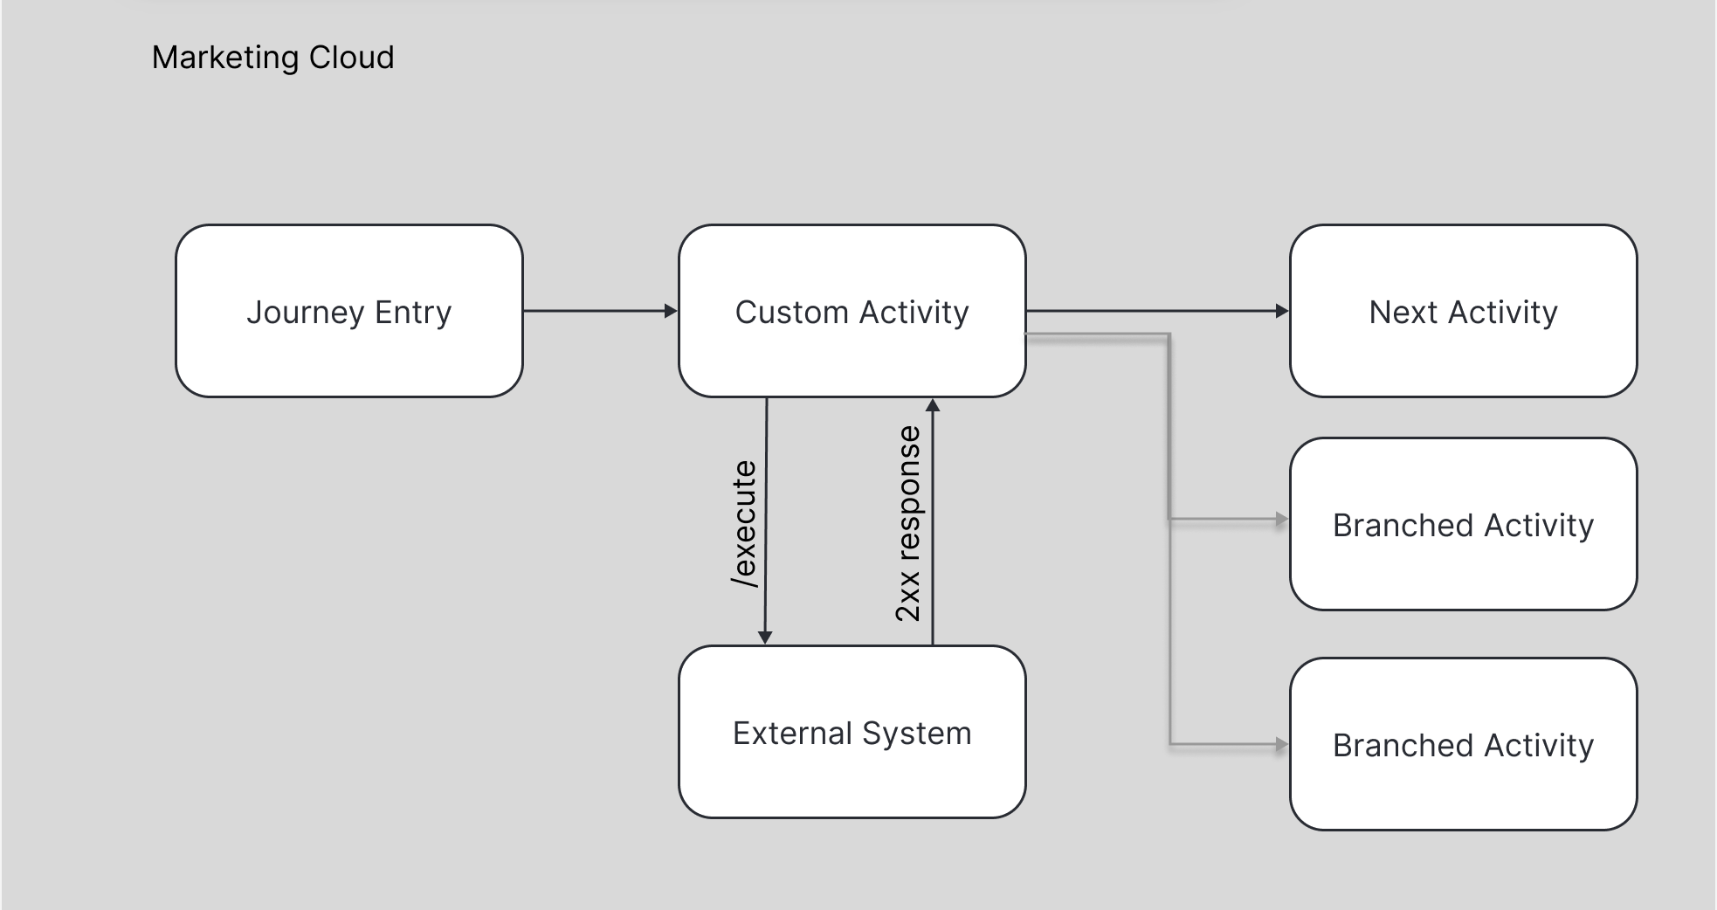
Custom Journey Builder Activity
Notes:
Similar to content block, jb app is also iframed and the data flow works like this..
A contact, as usual, would enter the journey, navigate to custom activity, which might make an api call to external system and then on successful completion, would navigate to next activity

Slide 18
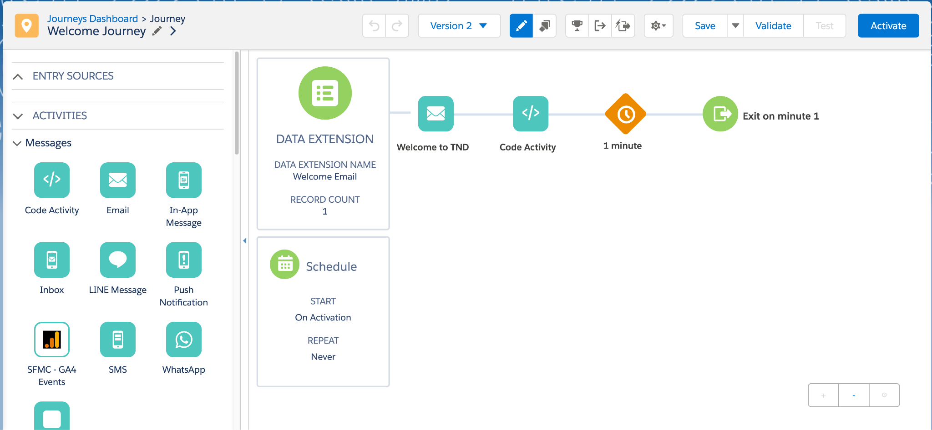
Custom Journey Builder Activity
Notes:
Here are some example custom JB Activities.
First is that different looking icon - SFMC - GA4 Events - a custom activity for sending events to GA4.
And next, remember how Automation Studio has a script activity but Journey Builder doesn’t… and that’s why you’ve SDK’s to build them.. A custom ‘Code’ JB Activity as you see here. Shortly, we’ll see a demo of how to build it and how it works.

Slide 19
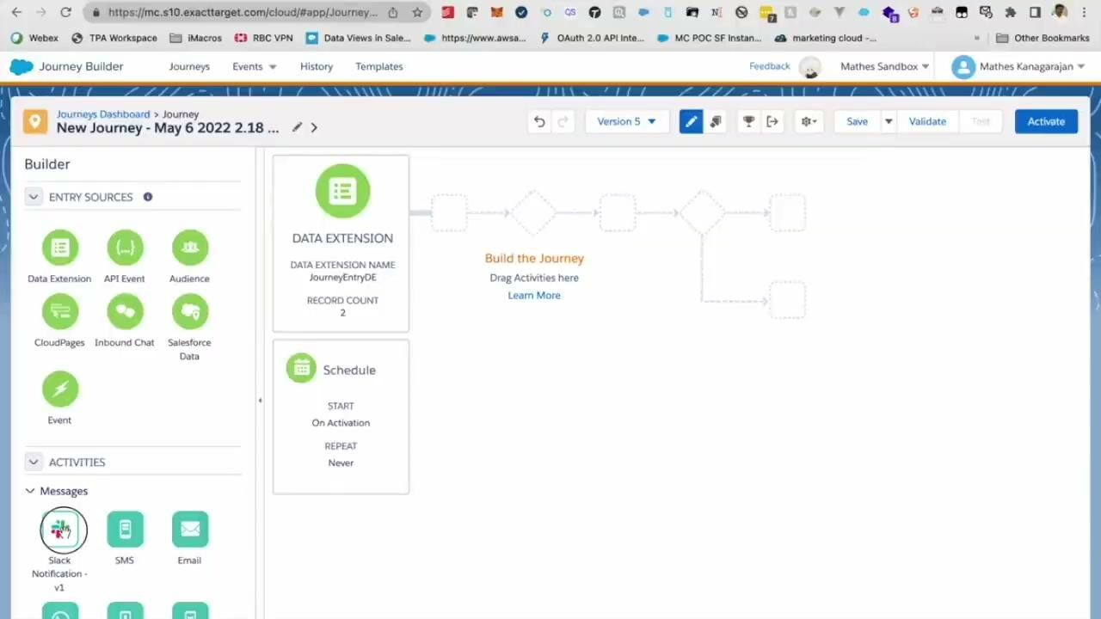
Custom Journey Builder Activity
Notes:
Here’s a sample Journey Builder Activity that I’ve built few years back - an activity that sends messages to slack when a customer flows through that branch.

Slide 20
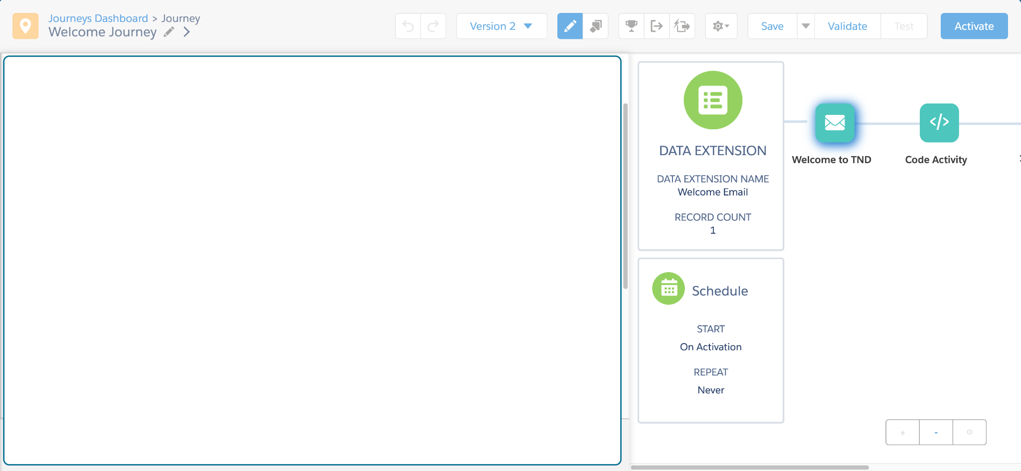
App Communication
iFramed JB App
Notes:
How does this works?
Once the app is added, it becomes available in iframe. Now, for the app to communicate with the journey, it uses ‘postmonger js’ - which a lightweight utility for cross-domain messaging, where (click) the app establishes a connection and triggers an event in the journey and then (click) the journey responds back with the data / context/ tokens etc., available in journey. Let’s look at the available events… (click)
—------ NOT NEEDED —----
How do you add a custom activity to your MCE instance?
Eg., URL - https://jb-code-activity.herokuapp.com/activities/code-activity/index.html or https://jb-code.pages.dev/

Slide 21
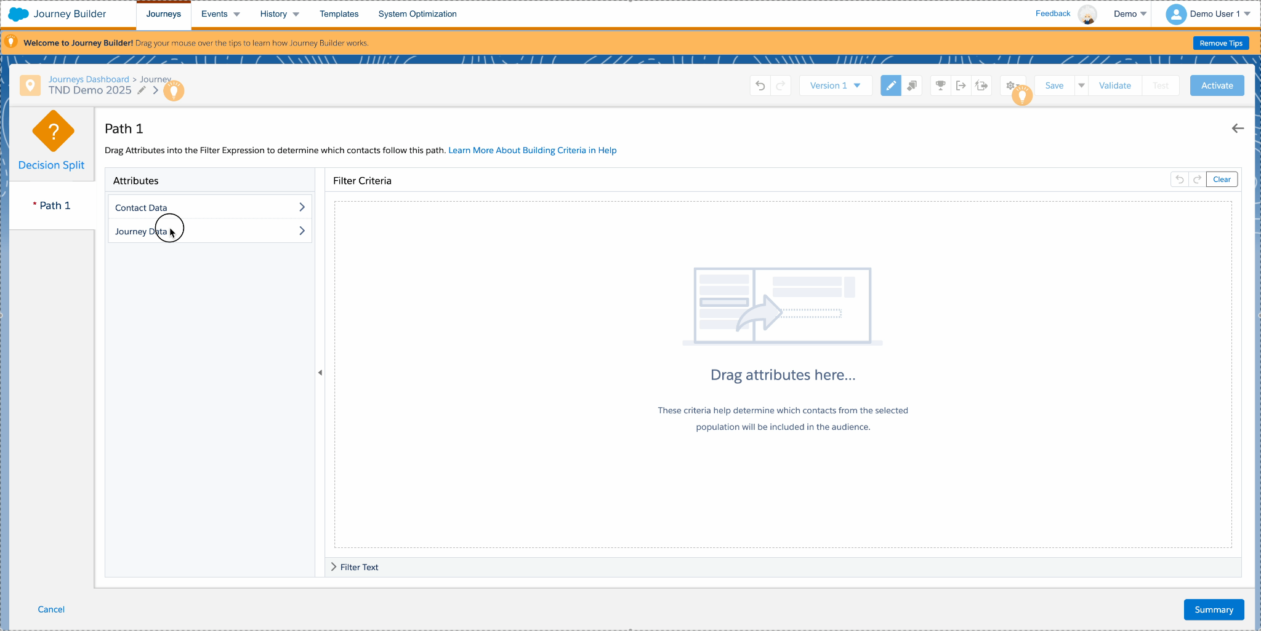
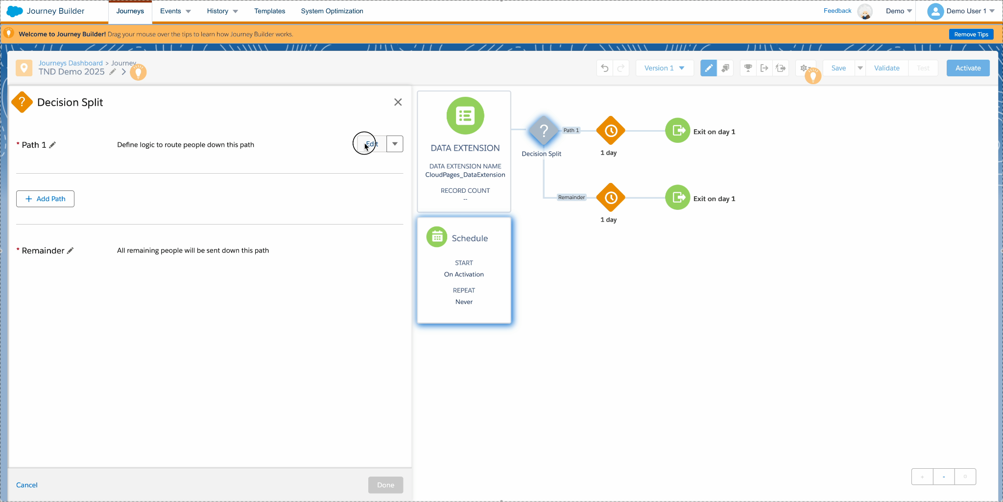
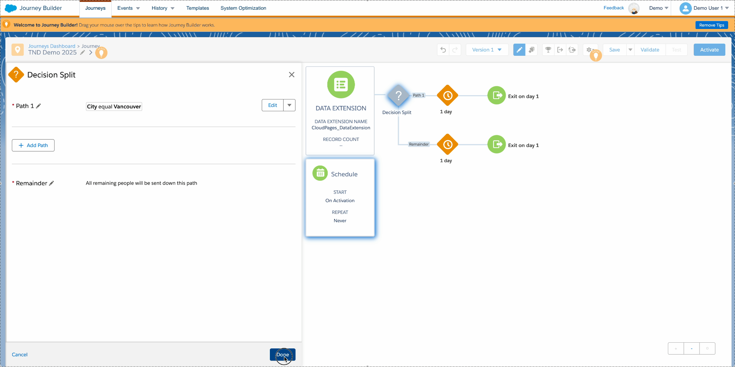
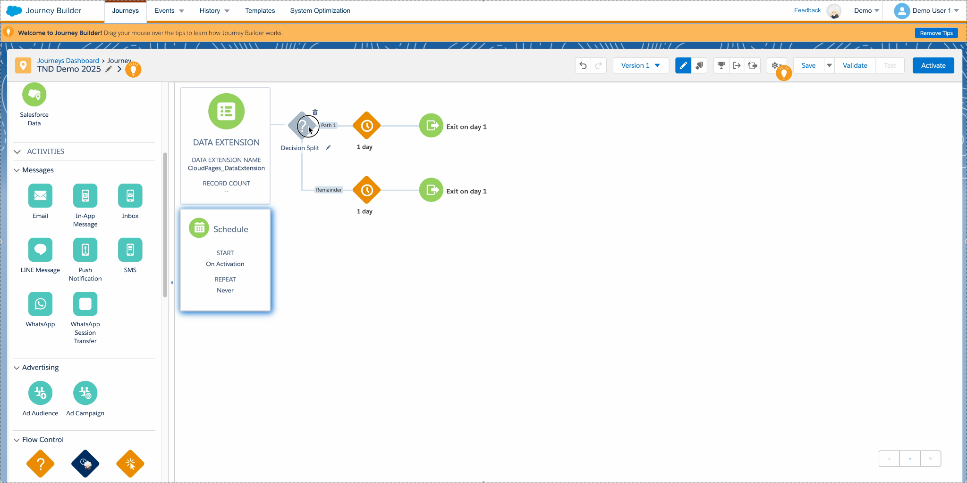
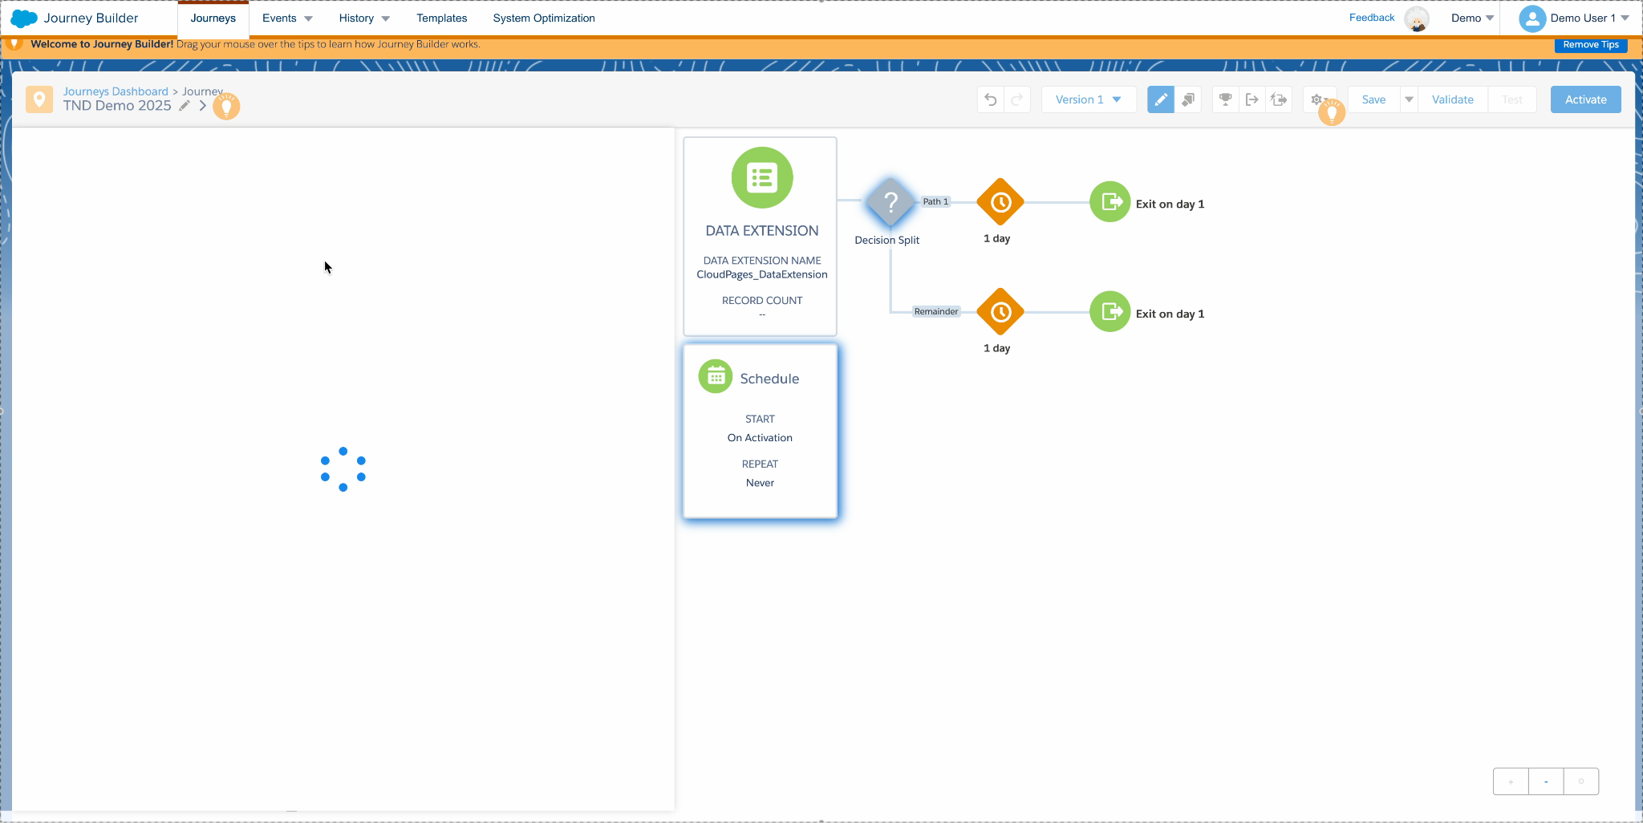
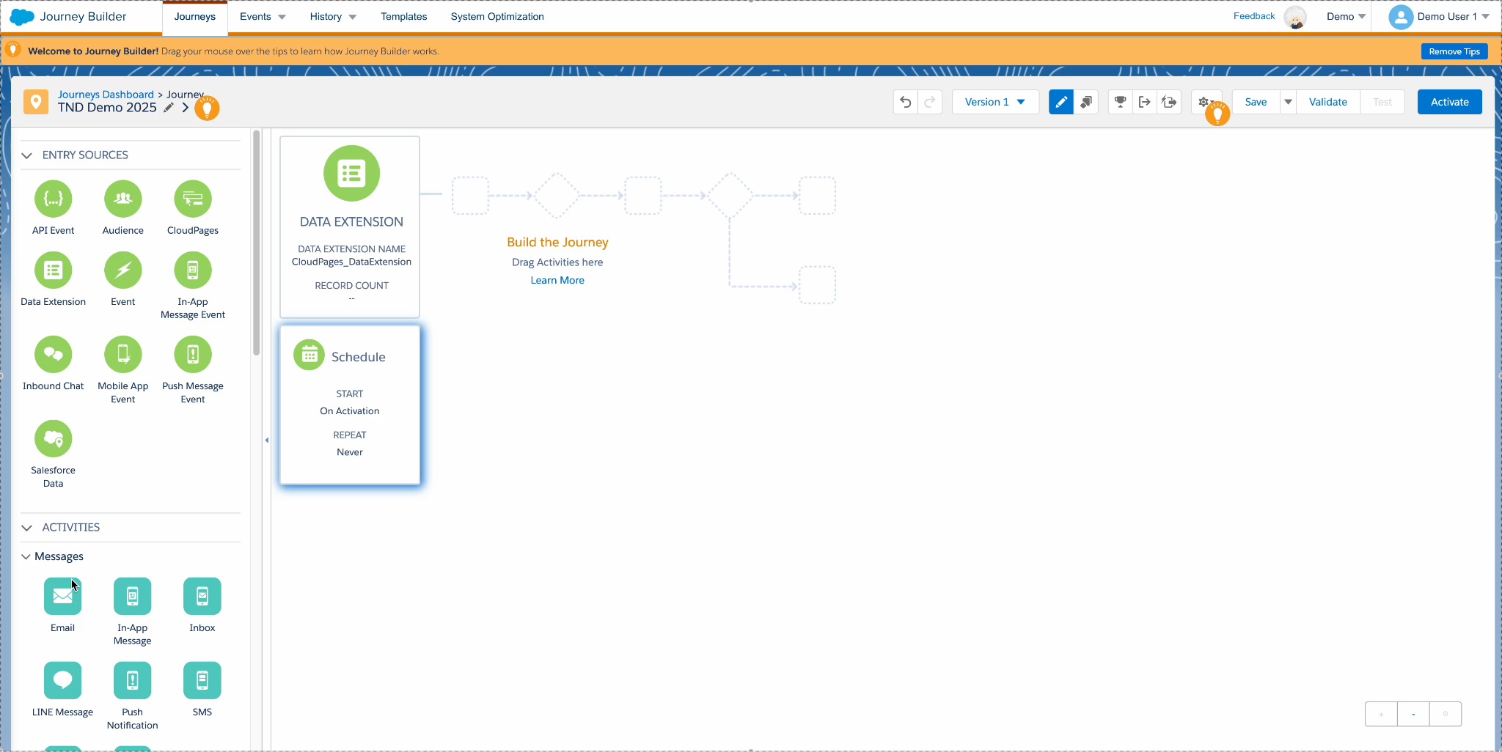
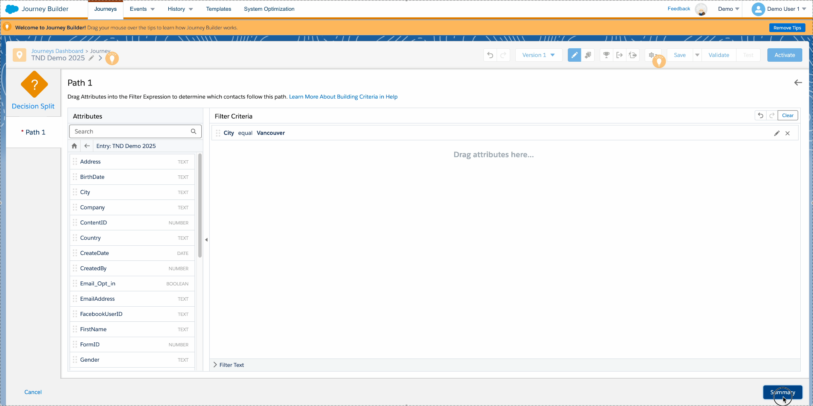
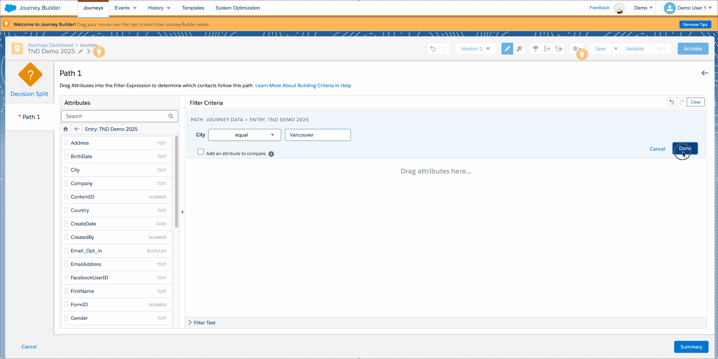
Cross-frame communication
Payload - requestDataSources:
[
{
"id": "Event",
"name": "Entry: Welcome Journey",
"eventDefinitionKey": "DEAudience-7f87bab2-2cb6-a90f-b817-2614a22f4ff6",
"keyPrefix": "Event.DEAudience-7f87bab2-2cb6-a90f-b817-2614a22f4ff6.",
"schema": null,
"deSchema": {
"fields": [
]
},
"dataExtensionId": "0b7dc130-811c-f011-b875-48df37dc1601"
}
]
connection.trigger(‘ready’)
Payload - requestDataSources:
{
"schemaReponse":
{
"schema": {
"attributeGroups" : [
{
"definitionKey": "ETSystem",
"definitionName": {
"value": "System Data"
}
}, ...
]
}
}, ...
}
Payload: {
"name": "Code Activity",
"id": "29de3a40-ab4e-446e-ba0f-62c70fa31fbe",
"key": "CODE-1",
"type": "CODE",
"arguments": {
...
},
"configurationArguments": {
"applicationExtensionKey": "764db5e9-693f-4f1f-85b2-adce01e4e895"
},
"metaData": {
"icon": "./images/code-icon.png"
},
"schema": {
...
},
"editable": false,
"outcomes": [
...
]
}
connection.on( 'initActivity', function( payload ) {
connection.trigger(‘requestDataSources’)
Payload:
{
"metaData": {
"isConfigured": true
}
}
connection.trigger(‘requestContactsSchema’)
connection.trigger(‘updateActivity’, payload)
connection.trigger(‘updateStep’, payload)
Notes:
Step 1 - Notify JB that iframe is ready
Step 2 - Wait for initActivity from JB
This payload lets you:
Pre-populate UI with saved config
Understand the context (e.g. journeyId, activityId)
Check if it's the first time opening or editing an existing activity

Slide 22
Custom Journey Builder Activity
Architecture
Custom Journey Builder App
Journey Builder
connection.trigger(‘ready’)
config.json
index.html
customActivity.js
connection.trigger(‘requestDataSources’, ‘requestContactsSchema’)
/js
Execute method and return data
require.js
connection.trigger(‘requestCulture’, ‘requestEndpoints’, ‘requestTokens’)
jquery.min.js
postmongor.js
connection.trigger(‘requestInteraction’, ‘requestInteractionsDefault’)
/images
icon.png
connection.trigger(‘nextStep’ / ‘prevStep’ / ‘updateStep’)
connection.trigger(‘updateStep’/ ‘updateActivity’, payload)
Notes:
Let’s talk about some of the available triggers
1. ready - this gets executed when the activity is dropped into the Journey builder canvas and invoked / clicked open
2. requestDataSources - this gets the schema of the entry source - say, if you’ve used a DE, it returns all the column names, type etc., - this is really helpful. What if you want to get ‘contact data’ from your contact model ? Here’s an undocumented event requestContactsSchema that returns the schema of your contact data model - fun inn’t
3. RequestTokens / culture/ endpoints - these can be invoked if needed and will return access token ,endpoint and internationaliztion details
4. Request interaction & interactionDefault - these gets the details of the current journey - like the ID, activities available and default values selected etc.,
5. Next, previous and update steps - if you’d like to build an app with a multi-step activity modal, use these on respective button clicks
6. Update step, activity - these are the ones that marks the activity as ‘successfully configured’ and then, and only then, you’ll be able to close the modal, validate the journey etc.,

Slide 23
Custom Journey Builder Activity
Architecture
Custom Journey Builder App
Journey Builder
connection.trigger(‘ready’)
config.json
index.html
customActivity.js
connection.trigger(‘requestDataSources’,, ‘requestContactsSchema’)
/js
Execute method and return data
require.js
connection.trigger(‘requestCulture’ / ‘requestEndpoints’, ‘requestTokens’)
jquery.min.js
postmongor.js
connection.trigger(‘requestInteraction’, ‘requestInteractionsDefault’)
/images
icon.png
connection.trigger(‘nextStep’ / ‘prevStep’ / ‘updateStep’)
connection.trigger(‘updateStep’/ ‘updateActivity’, payload)
Notes:
Next, (click) let’s look at the app strutrue and the comoponents in building a custom JB app - to the left.
First and the most important file is config.json (click), hosted at the root, containing configuration information about our app.
(click) As mentioned earlier, for cross-frame & cross-origin communication, we need postmongor.js
Next, (click) our index.html file for UI and then (click) a customActivity js file that’s the meat of your app - that imports postmongor using require js (click) and invokes all these said activities like ready, requestDataSource etc.,.. And it’ll also contain the function that executes when journey builder responds back with data. Eg.,
connection.on( 'initActivity', function( payload ) {
(click) and ofcourse, we’ll need icon for your app

Slide 24
Custom Journey Builder Activity
Demo time!! *
*At the Mercy of Demo Gods!

Slide 25
Custom Apps

Slide 26
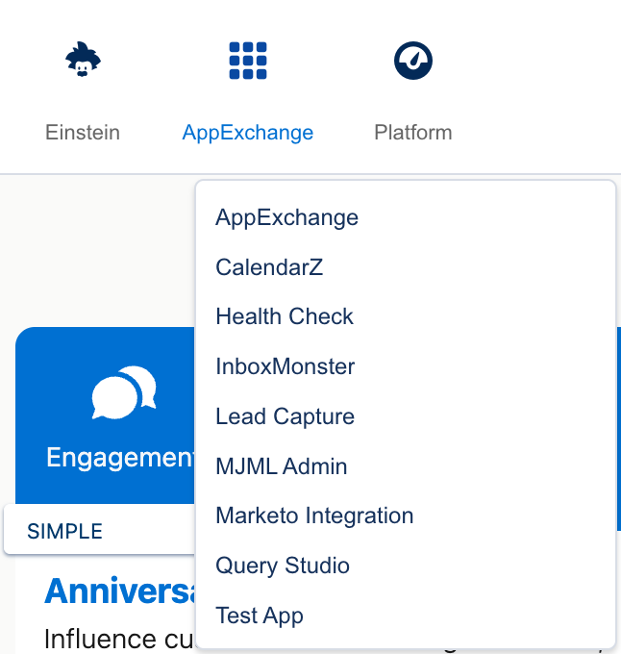
Custom App
Externally hosted & iframed app accessible from AppExchange
Well known apps
Query Studio
DE Select Segmentation
Health Check for Marketing Cloud - by CloudKettle
Notes:
Next is, building custom apps. These are the apps that are hosted externally and can be accessed from AppExchange section in your SFMC instance.
To give you some well known apps as an example,
First is, the every green Query Studio - built by Salesforce labs and been used for more than a decade…
Next, visual segmentation creation tool from DESelect
And last but not lead, health check app from CloudKettle.

Slide 27
Custom App
App structure
The app needs 3 things
Login endpoint
Logout endpoint
App index URL
Authenticate with 3-legged oAuth 2.0 Authorization code flow
Notes:
When you build your app, and especially if you’d like to publish it, which we’ll see how in a while, you need to keep three things in mind.
First, have an auto login endpoint that can handle 3-legged oauth 2.0 authroization code flow and retain the code & refresh token.. And, as soon as the token is available, make a userInfo api call to get user details - completely optional and up to you.
And then, have an endpoint to logout - which woud necesssarily unset the cookie and end user’s session.
And finally, the most important aspect is the main app itself which can be access from index url.

Slide 28
Custom App
APIs & SDKs
REST & SOAP APIs
Fuel SDKs
Python
Java
C#
PHP
Ruby
NodeJS
Notes:
Since the app now have oauth access token, you can access the contents of marketing cloud using rest and soap apis. Also, Fuel SDK is available in multiple languages like python, java, c sharp, php, ruby, nodejs - although, most of the sdks have limited funciotns available and not maintained.
For example, some of the sdk’s were last updated about 6 years back.. So, I’d rather use rest / soap apis that has better coverage and support and thereby realiable

Slide 29
App Publishing

Slide 30
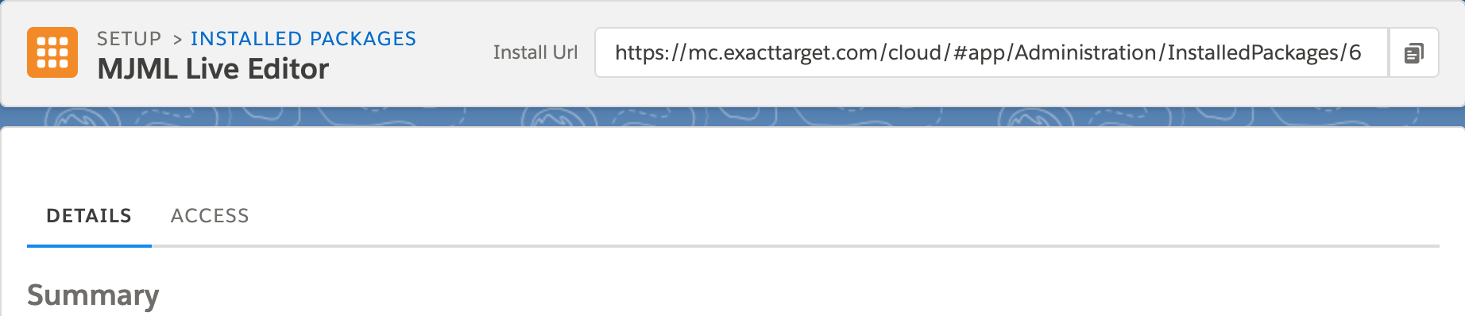
App Publishing
Use in your MC Org
Publish in AppExchange
Add the app to Installed Package
Change Access Level to appropriate BU and users
Create Partner Account
Submit Business Plan
Explain your app
Free/ Paid
Submit app for security review (installed package)
App listing in AppExchange
Notes:
If you would like to use the app - be it custom content block, journey builder activity or MC App, you could create an installed package, add your app and provide access to respective users and business units.
And if you want the app to be available in appexchange for others to install and use, then go for publishing route.
There are certain key steps that’s common between publishing a sf & mc app - like becoming a partner, submitting business plan where you also decide if your app is going to be paid / free, then submit your app for security review, and post approval and listing, the installed package in your partner marketing cloud account will look like this (click) ,with ‘Install URL’ that you can add to in AppExchange, or use directly to install your app.

Slide 31
Chrome Extension

Slide 32
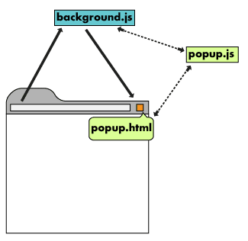
Architecture
Components
background.js
popup.js
popup.html
Notes:
Background js - to monitor the page and stay active
popup.js - when the extension is clicked, this gets executed
Popup.html - the ui that gets displayed

Slide 33
Publishing
Steps
Register for Chrome Dev account
Compress the project and upload (do not obfuscate)
Provide explanation about your extension
Review process (~72 hours)
Approved & published

Slide 34
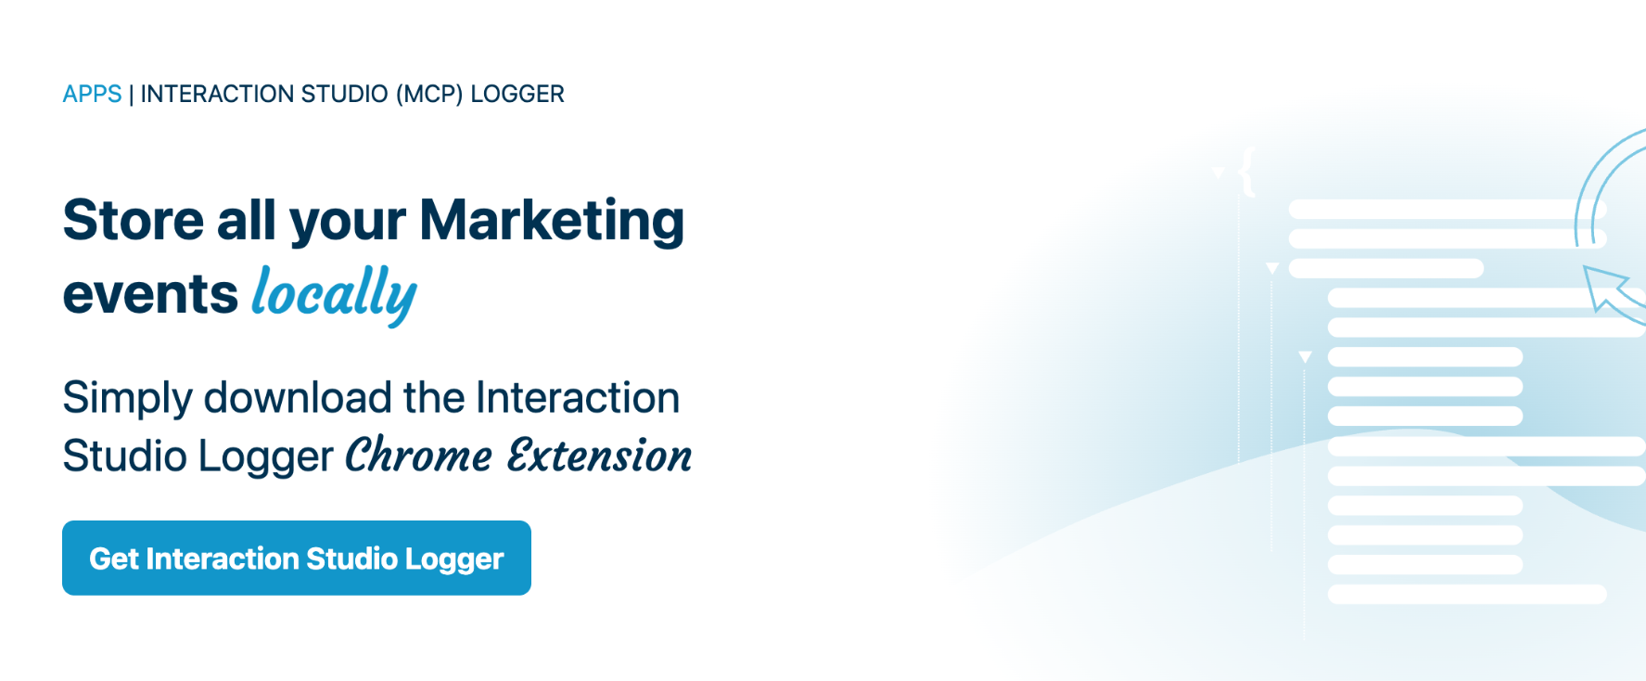
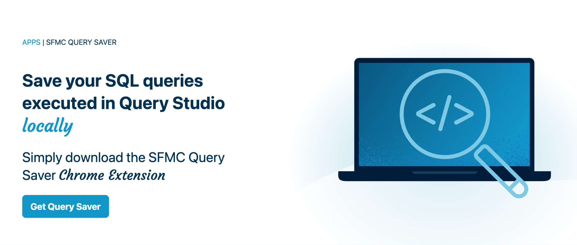
Publishing
SFMC Extensions
Notes:
From CK, we’ve build few extension like SFMC Query Saver, SFMC Automation Viewer and MCP Logger

Slide 35
Custom Journey Builder Activity
Demo time!! *
*At the Mercy of Demo Gods!
Notes:
A simple demo to display all available journeys in your account

